Slide 1
Permutation Test
Empirical Null Odds Ratio Distribution
Is Protein Network "X" statistically more often mutated congenital heart disease probands than in healthy controls?
with Maureen Pittman (Pollard Lab)
Notes:
Then in an instrumental collaboration with Katie pollard lab, Maureen Pittman, a very talented gard student, designed a permutation test allowed us to statistically analyze if the genes encoding a protein network X, in this case the GATA4 or TBX5 interactome network, are more often mutated in patients with Congenital Heart Disease than in healthy controls.
This test generates the figure you see on the left of the slide.
1) First generates the expected distribution of how frequently the variants tested occur in the Protein network X in a population in which case/control status doesn't matter (case/control labels have been randomly shuffled and repeted 1000 times to create the odds ratio distribution). This distribution generatded, usually follows a Gausian distribution.
2) then it calculates the TRUE Odds ratio (represented with a red vertical dahed line) that indicates the likelihood of the variants selected occuring in the Protein network X and in a Congenital heart disease case.

Slide 2
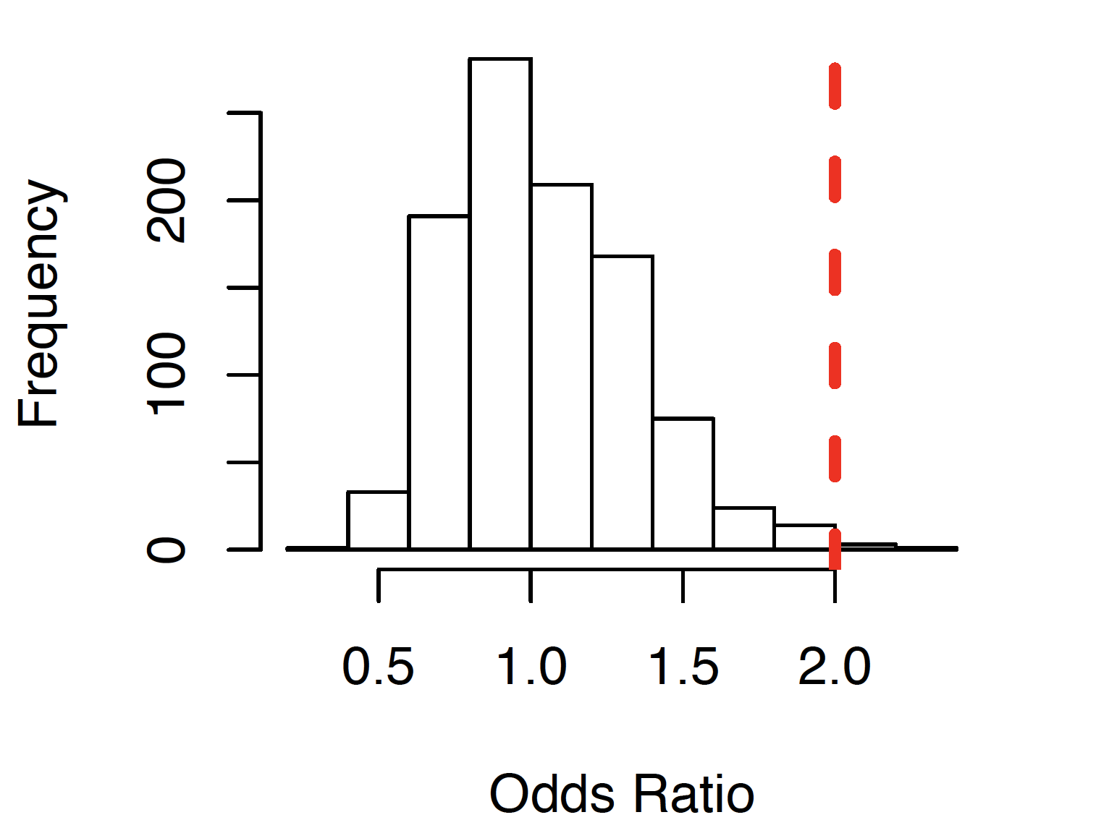
Permutation Test
Empirical Null Odds Ratio Distribution
Is Protein Network "X" statistically more often mutated congenital heart disease probands than in healthy controls?
If YES:
True Odds Ratio (red line) falls in or beyond the right tail of the frequency distribution.
with Maureen Pittman (Pollard Lab)
Notes:
Then in an instrumental collaboration with Katie pollard lab, Maureen Pittman, a very talented gard student, designed a permutation test allowed us to statistically analyze if the genes encoding a protein network X, in this case the GATA4 or TBX5 interactome network, are more often mutated in patients with Congenital Heart Disease than in healthy controls.
This test generates the figure you see on the left of the slide.
1) First generates the expected distribution of how frequently the variants tested occur in the Protein network X in a population in which case/control status doesn't matter (case/control labels have been randomly shuffled and repeted 1000 times to create the odds ratio distribution). This distribution generatded, usually follows a Gausian distribution.
2) then it calculates the TRUE Odds ratio (represented with a red vertical dahed line) that indicates the likelihood of the variants selected occuring in the Protein network X and in a Congenital heart disease case.

Slide 3
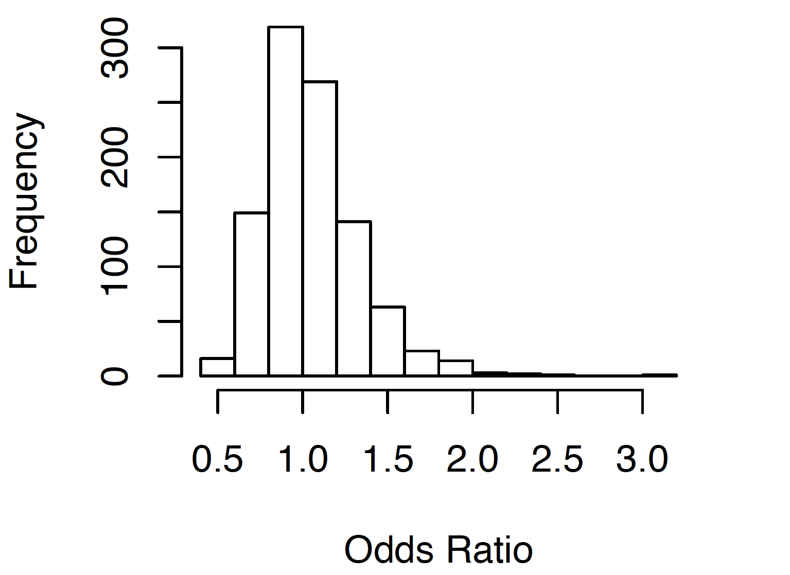
GATA4 Interactome Reveals Enrichment in De Novo Variants Associated with CHD
De Novo Non-synonymous Variants
with Maureen Pittman (Pollard Lab)
Notes:
Firstly, Maureen run the permutation test fisrt for DE NOVO non-synonymous mutations from the PCGC dataset in the GATA4 interactome network, and was able to show that based on the Odds ratio

Slide 4
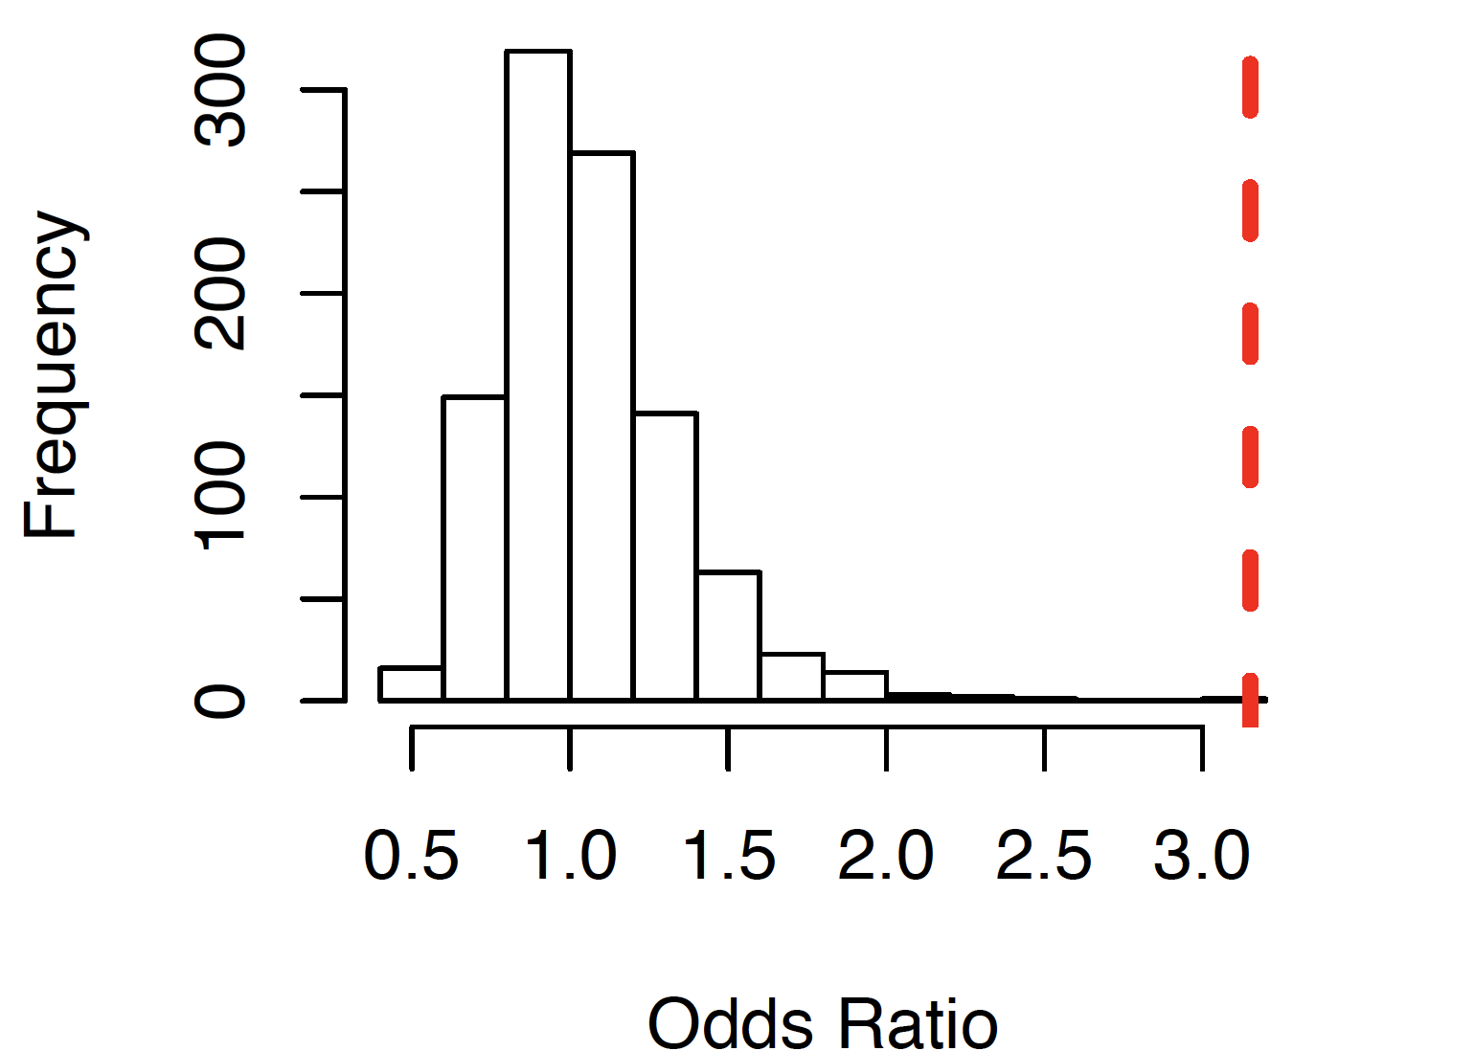
GATA4 Interactome Reveals Enrichment in De Novo Variants Associated with CHD
De Novo Non-synonymous Variants
p-value: 0.002
with Maureen Pittman (Pollard Lab)
Notes:
Firstly, Maureen run the permutation test fisrt for DE NOVO non-synonymous mutations from the PCGC dataset in the GATA4 interactome network, and was able to show that based on the Odds ratio

Slide 5
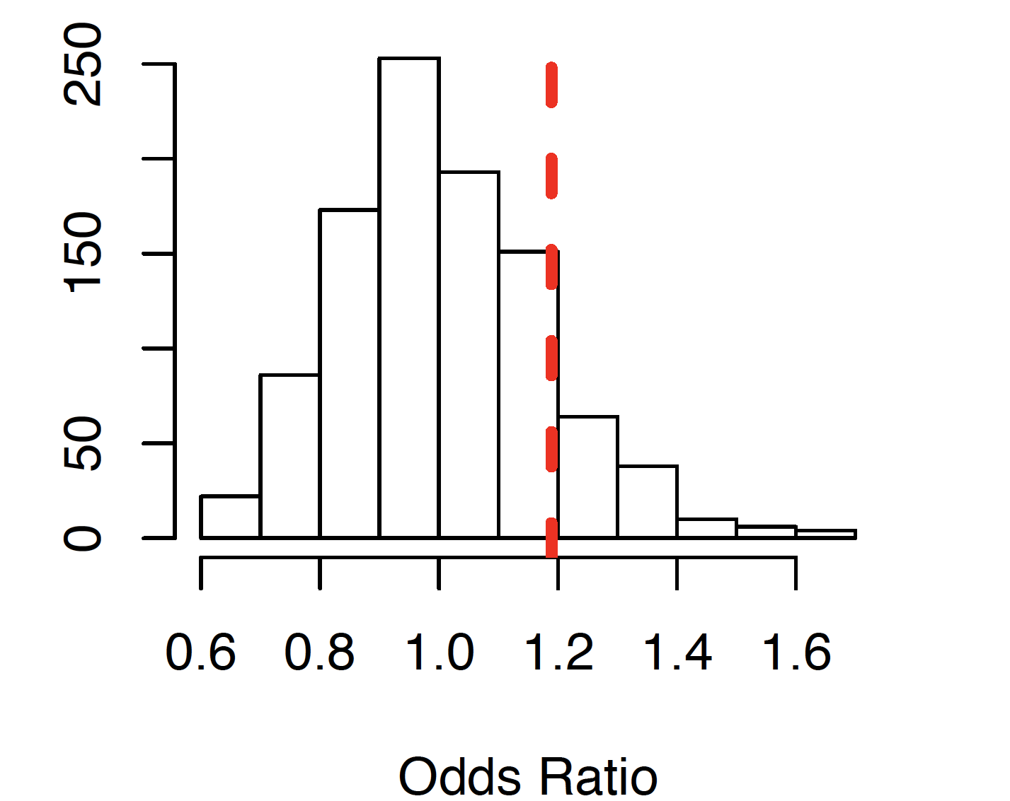
GATA4 Interactome Reveals Enrichment in De Novo Variants Associated with CHD
De Novo Non-synonymous Variants
Inherited Loss of Function Variants
p-value: 0.002
p-value: 0.111
Notes:
Firstly, Maureen run the permutation test fisrt for DE NOVO non-synonymous mutations from the PCGC dataset in the GATA4 interactome network, and was able to show that based on the Odds ratio

Slide 6
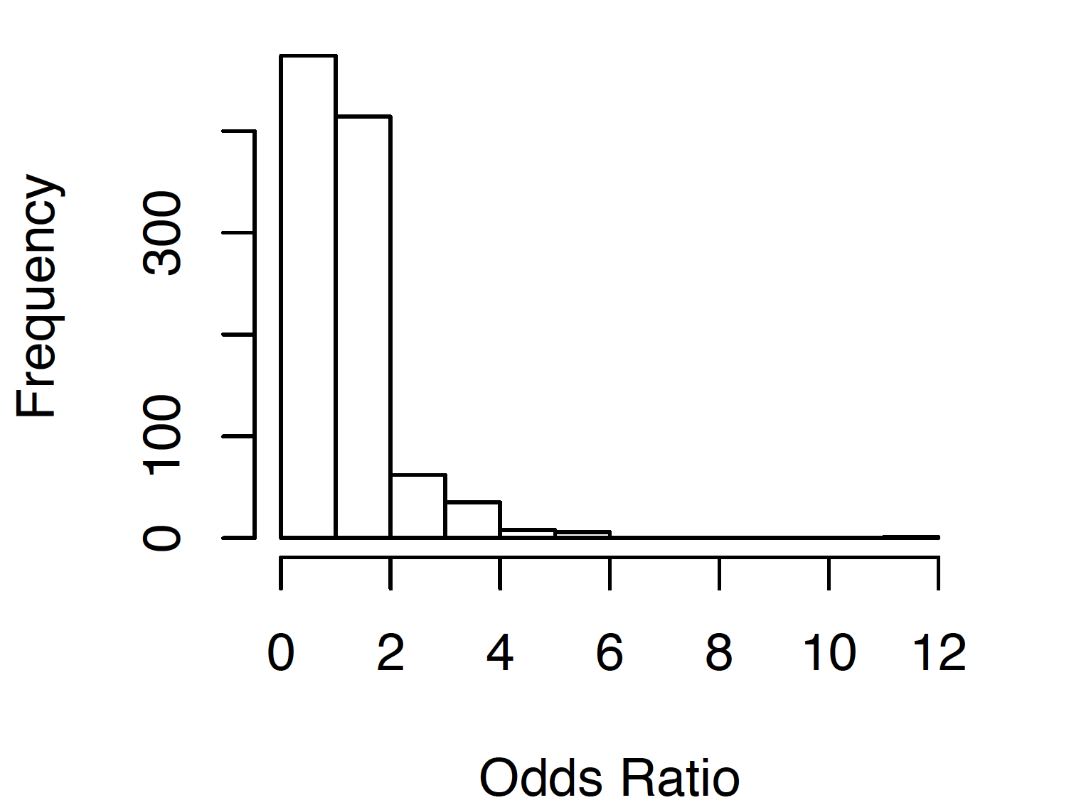
TBX5 Interactome Reveals Enrichment in De Novo Variants Associated with CHD
De Novo Non-synonymous Variants
Odds Ratio
with Maureen Pittman (Pollard Lab)
Notes:
Then we run the same permutation test for TBX5 interactome, and also observed based in the odds ratio and the p value, that TBX5 interactome nertwork genes have more frequently de novo non-synonymous variants in patients with CHD than in healthy controls.

Slide 7
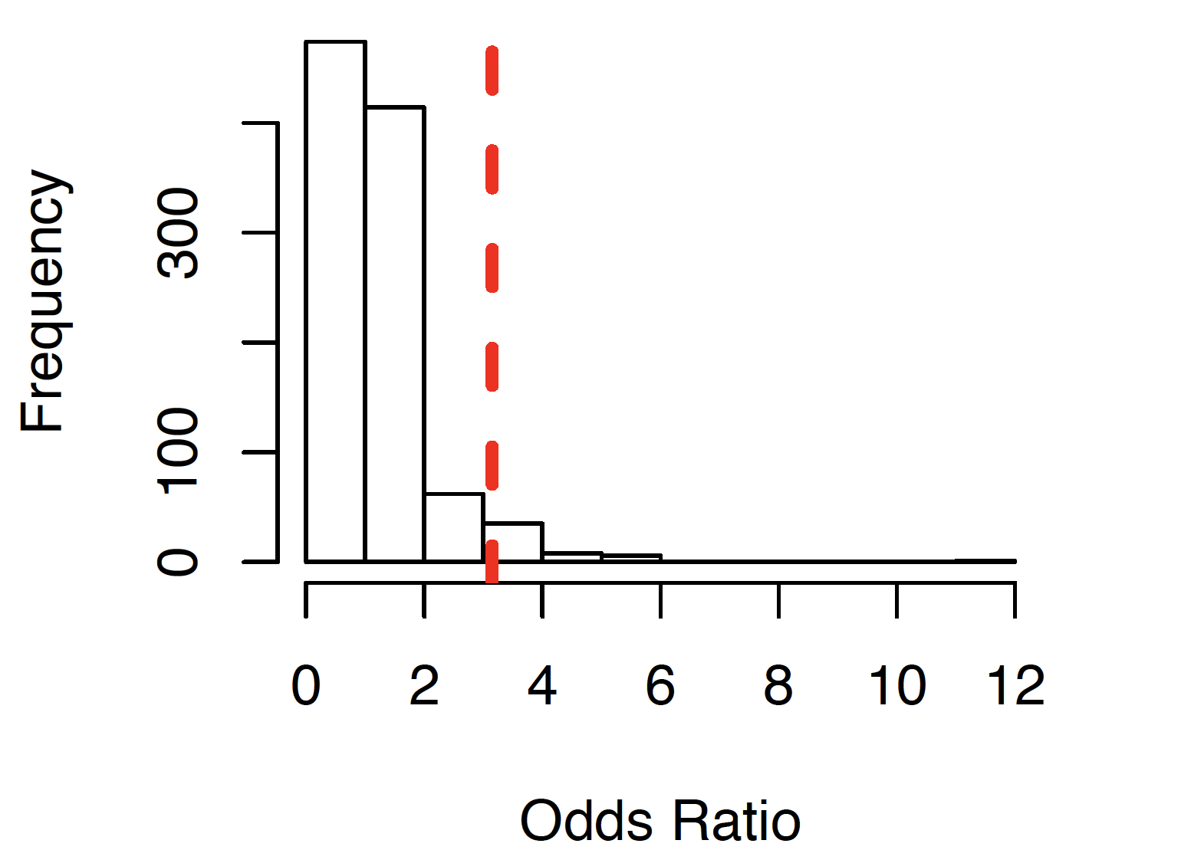
TBX5 Interactome Reveals Enrichment in De Novo Variants Associated with CHD
De Novo Non-synonymous Variants
Odds Ratio
p-value: 0.02
with Maureen Pittman (Pollard Lab)
Notes:
Then we run the same permutation test for TBX5 interactome, and also observed based in the odds ratio and the p value, that TBX5 interactome nertwork genes have more frequently de novo non-synonymous variants in patients with CHD than in healthy controls.

Slide 8
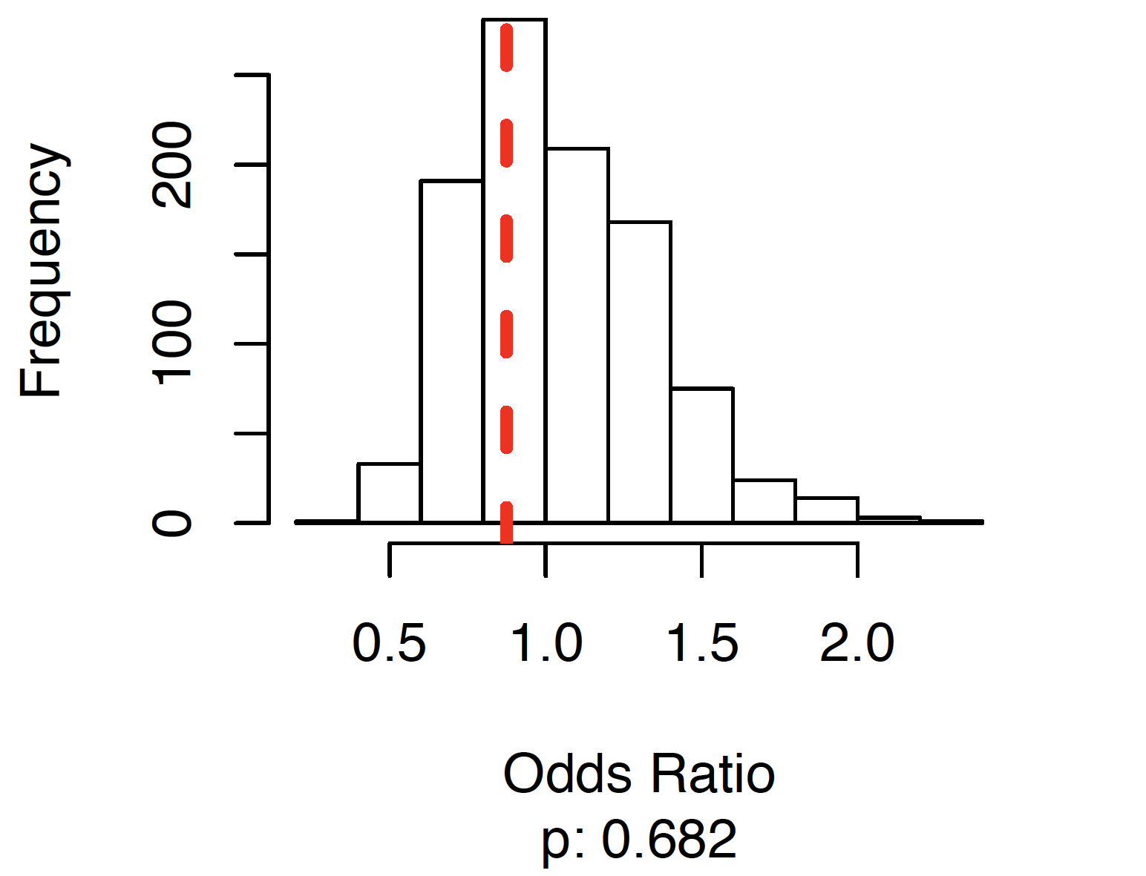
TBX5 Interactome Reveals Enrichment in De Novo Variants Associated with CHD
De Novo Non-synonymous Variants
Inherited Loss of Function Variants
Odds Ratio
p-value: 0.02
Notes:
Then we run the same permutation test for TBX5 interactome, and also observed based in the odds ratio and the p value, that TBX5 interactome nertwork genes have more frequently de novo non-synonymous variants in patients with CHD than in healthy controls.

Slide 9
TBX5 Interactome Reveals Enrichment in De Novo Variants Associated with CHD
De Novo variants in GATA4 and TBX5 interactome genes occur more often in congenital heart disease than in healthy controls
De Novo Non-synonymous Variants
Inherited Loss of Function Variants
Odds Ratio
p-value: 0.02
Notes:
Then we run the same permutation test for TBX5 interactome, and also observed based in the odds ratio and the p value, that TBX5 interactome nertwork genes have more frequently de novo non-synonymous variants in patients with CHD than in healthy controls.

